Slide 1
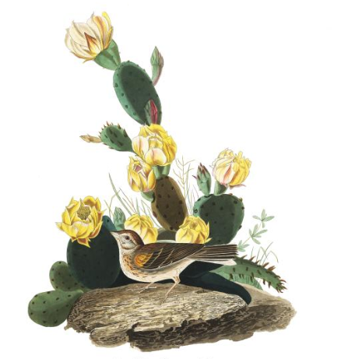
Linking avian pollination and frugivory to Cactaceae seed dispersal and successful facilitation.
Malory Owen
Master’s Thesis Proposal
Principal Investigator: Dr. Chris Lortie
Committee: Dr. Chris Lortie & Dr. Bridget Stutchbury

Slide 2
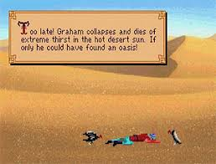
Positive Interactions in the Desert
Positive Interactions
Facilitation
Benefactor/protégé
Foundational species
Keystone species
Desert Ecosystems
Provides water and shade
Protects against herbivory, wind, & freezing temperature
Seeds must get to benefactor
benefactor plant
Notes:
A positive interaction is where by the associating between two (or more) interspecifics, at least one’s relative fitness is increased. Usually referred to by the pathway that the interaction follows: plant-plant, plant-anima. Can also be three or more: plant-plant-animal, plant-animal-plant, etc.
Facilitation is a common example of a positive interaction—it’s when a benefactor plant (for example, a shrub) provides some benefit to a protégé plant when the protégé grows under the benefactor’s canopy.
When this happens and a single benefactor species is responsible for the recruitment of many different other plant species, and provides goods to animals (or even microbes) as well to the end that the ecosystem is strongly altered by the presence or absence of that benefactor, that species is known as a foundational species—since it is the foundation for an entire ecosystem.
Often, you may also call these a keystone species, which is a species that has interactions with other species in the ecosystem, determining the make up of them.
Keystone, foundational, and benefactor species aren’t always over lapping, but all work together to shape the ecosystem at large.
In arid ecosystems, benefactor plants provide water and shade from harsh solar radiation, and protect against herbivory, wind, and freezing temperatures for juvenile plants under its canopy. This totally not edited image tells the story of an unfortunate traveler who would’ve survived in the harsh desert if only they had found a benefactor plant.
But before a benefactor can even provide these services, the seeds from a mother plant must be dispersed to these favorable habitats.

Slide 3

Seed
?
?
Shadow
Notes:
I’m curious to what degree birds determine the seed shadow (or range of seed rain from the mother plant), and if they make that seed shadow fall in favorable environments (like under a benefactor shrub).
So the question is, are birds taking these purple paths to place seed rain under benefactor shrub canopies? Or to along the orange paths to end in the open? Or both, but only the seeds that rode along the purple path germinate?
What we do know is that birds pollinate flowers and disperse seeds (by eating the fruits), two positive interactions with cacti.

Slide 4
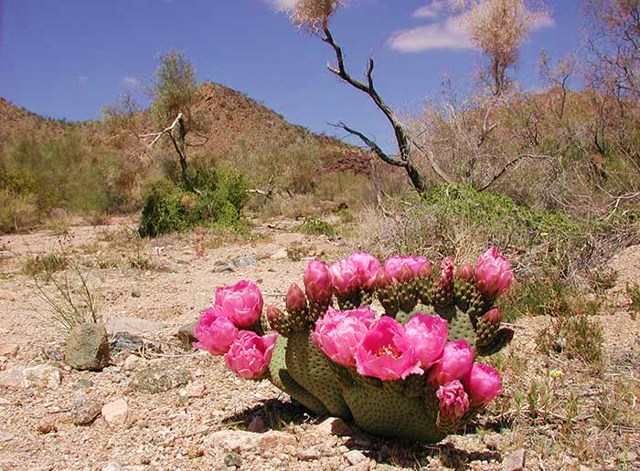
Pollination
Magnet Species Hypothesis
Notes:
Pollination (specifically by hummingbirds) is an early step in fruit production. Because of this, it’s important to consider pollination as a function of fruit production, and eventual seed dispersal. That is, a seed can’t be dispersed until it’s be created.
The magnet species hypothesis suggests that plants with “showier” flower displays (more inflorescences at higher levels) are likely to attract more pollinators. Because the pollinators are nearby, even near non-showy plants benefit from the showy-plant’s presence.
So not only are magnet plants and pollinators benefitting, but so are nearby plants.

Slide 5
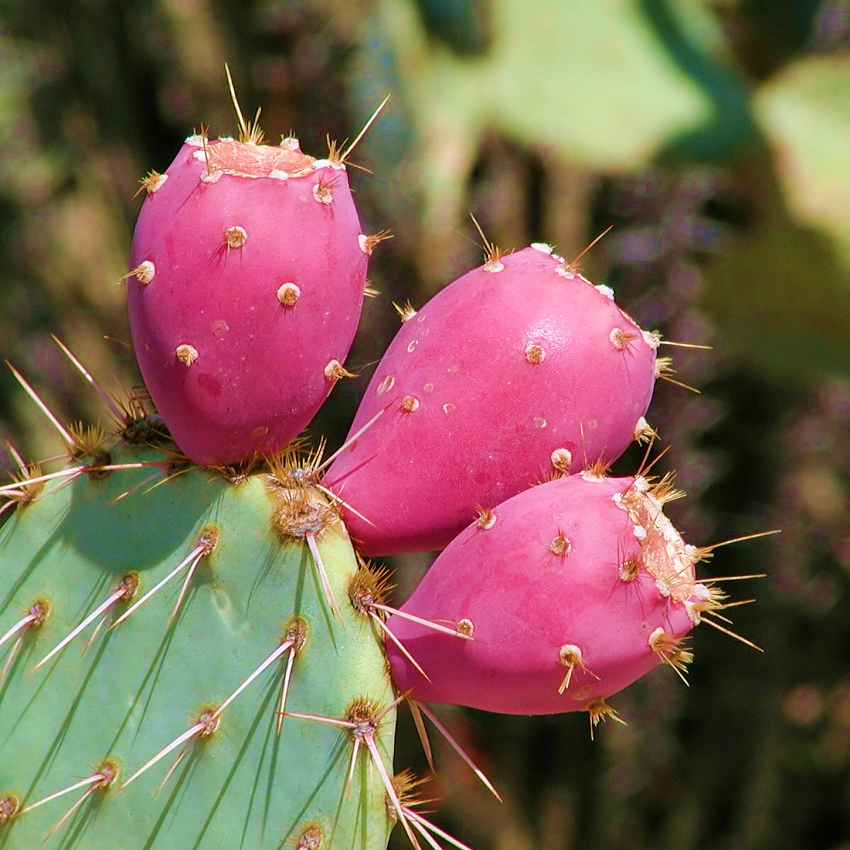
Seed Dispersal
Allocation theory
Notes:
Allocation theory is just the idea that different, competing plants must make different trade offs to fit different niches. In this study, we’ll be interested to see if our cacti of interest allocate resources (like nutrients) to both fruit and size—two factors that would potentially encourage frugivory, and therefore seed dispersal, to the end of increasing relative fitness.

Slide 6
Timeline
Chapter | Preliminary Field Season | Flowering Field Season | Fruiting Field Season | Data Analyzed | Paper written/ revised/ submitted
1 | Not applicable | Not applicable | Not applicable | December 2018 | February 2019
2 | February 2019 (1 week) | May 2019 (4 weeks) | August 2019 (4 weeks) | October 2019 | December 2019
3 | February 2020 (1 week) | May 2020 (4 weeks) | August 2020 (4 weeks) | October 2020 | December 2020
Notes:
Walk through timeline
Chapter 3 is going to have to be after I defend/if I switch to PhD/if I decide to stay longer? Issues of timing need to be discussed.

Slide 7
Chapter 1: Fruiting metrics in Cactaceae—A Meta-Analysis
Purpose:
Comprehensive review and analysis of fruit and seeds in Cactaceae
Synthesize reports on allocation theory
Research Questions:
Are fruit and seed size dependent?
Is there a relationship between reported individual fruit size and seed production?
Are size and branching related to age, and do they influence reproductive success independent of age?
Are cacti species nearer on the phylogenetic tree allocating energy in similar ways?

Slide 8
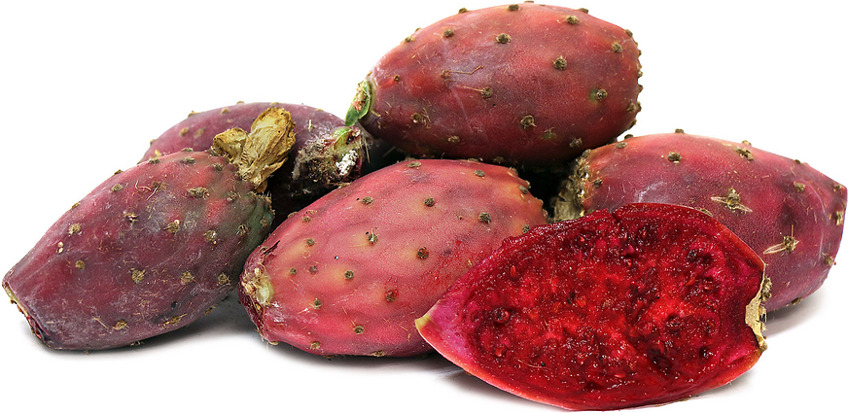
Methods
Search terms: “cact*”, “seed”, “fruit”, “allocat*”, and “size”
Must:
Published in last 5 years
Ecology in discipline
Report regression or correlation coefficient

Slide 9
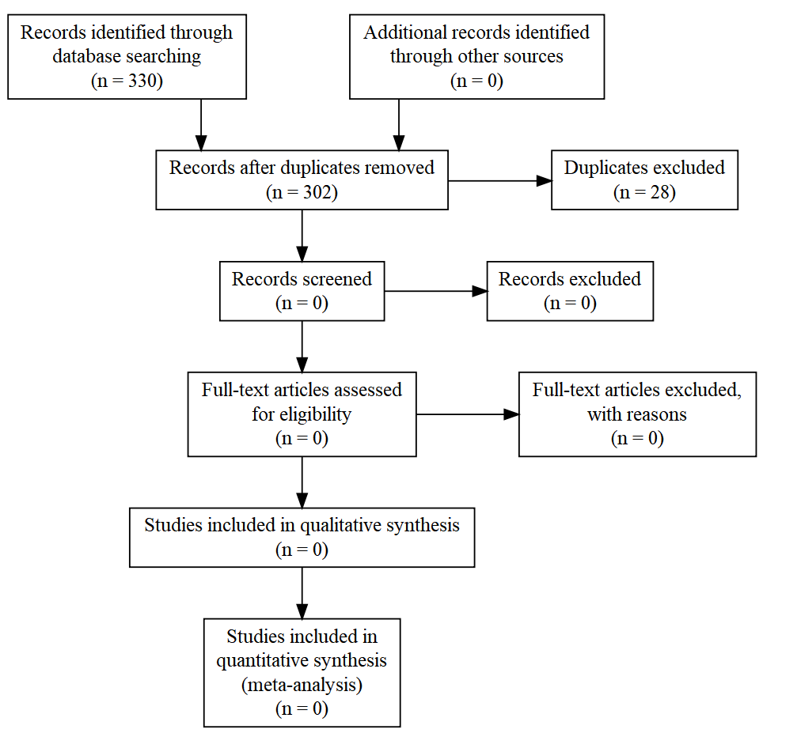
PRISMA flow diagram

Slide 10
Chapter 2: Strength of birds as pollinators and seed dispersers in Cactaceae
Purpose:
Test strength pollinating and frugivorous birds to observed and experimentally manipulated characteristics of 3 taxa of cacti
Research Questions:
Is cactus size an indicator for fruit mass/abundance? For flower abundance?
Is there a positive relationship between number of seeds per fruit and fruit size in the cacti of interest?
Are frugivorous birds stronger dispersers for larger cacti?
Are pollinating birds (hummingbirds) optimally foraging at larger cacti?

Slide 11
Hypothesis & Predictions
Hypothesis: Birds and cacti are linked through positive interactions in desert ecosystems, with plant size being a determining factor of interaction strength.
Predictions:
Cacti reproduction effort is size-dependent, and fruit and seed size are positively correlated.
Bird visitation rates for pollination and frugivory are positively related to cacti size and floral display.
The bird-cacti relationship is species specific (both for bird and cacti species).

Slide 12
Variables
Factors
Mesohabitat: Open/Cactus
Species
Size: Small, Medium, Large
Percent fruit/flower: 0%, 50%, 100%
Responses
Mass of individual fruits
Mass of individual seeds
Number of flowers per cactus
Number of fruits per cactus
Number of seeds per fruit
Species richness and diversity per cactus
Proportion of frugivorous birds present relative to non frugivorous birds

Slide 13
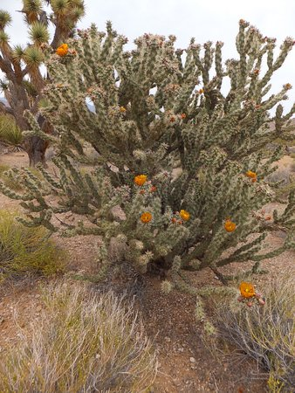
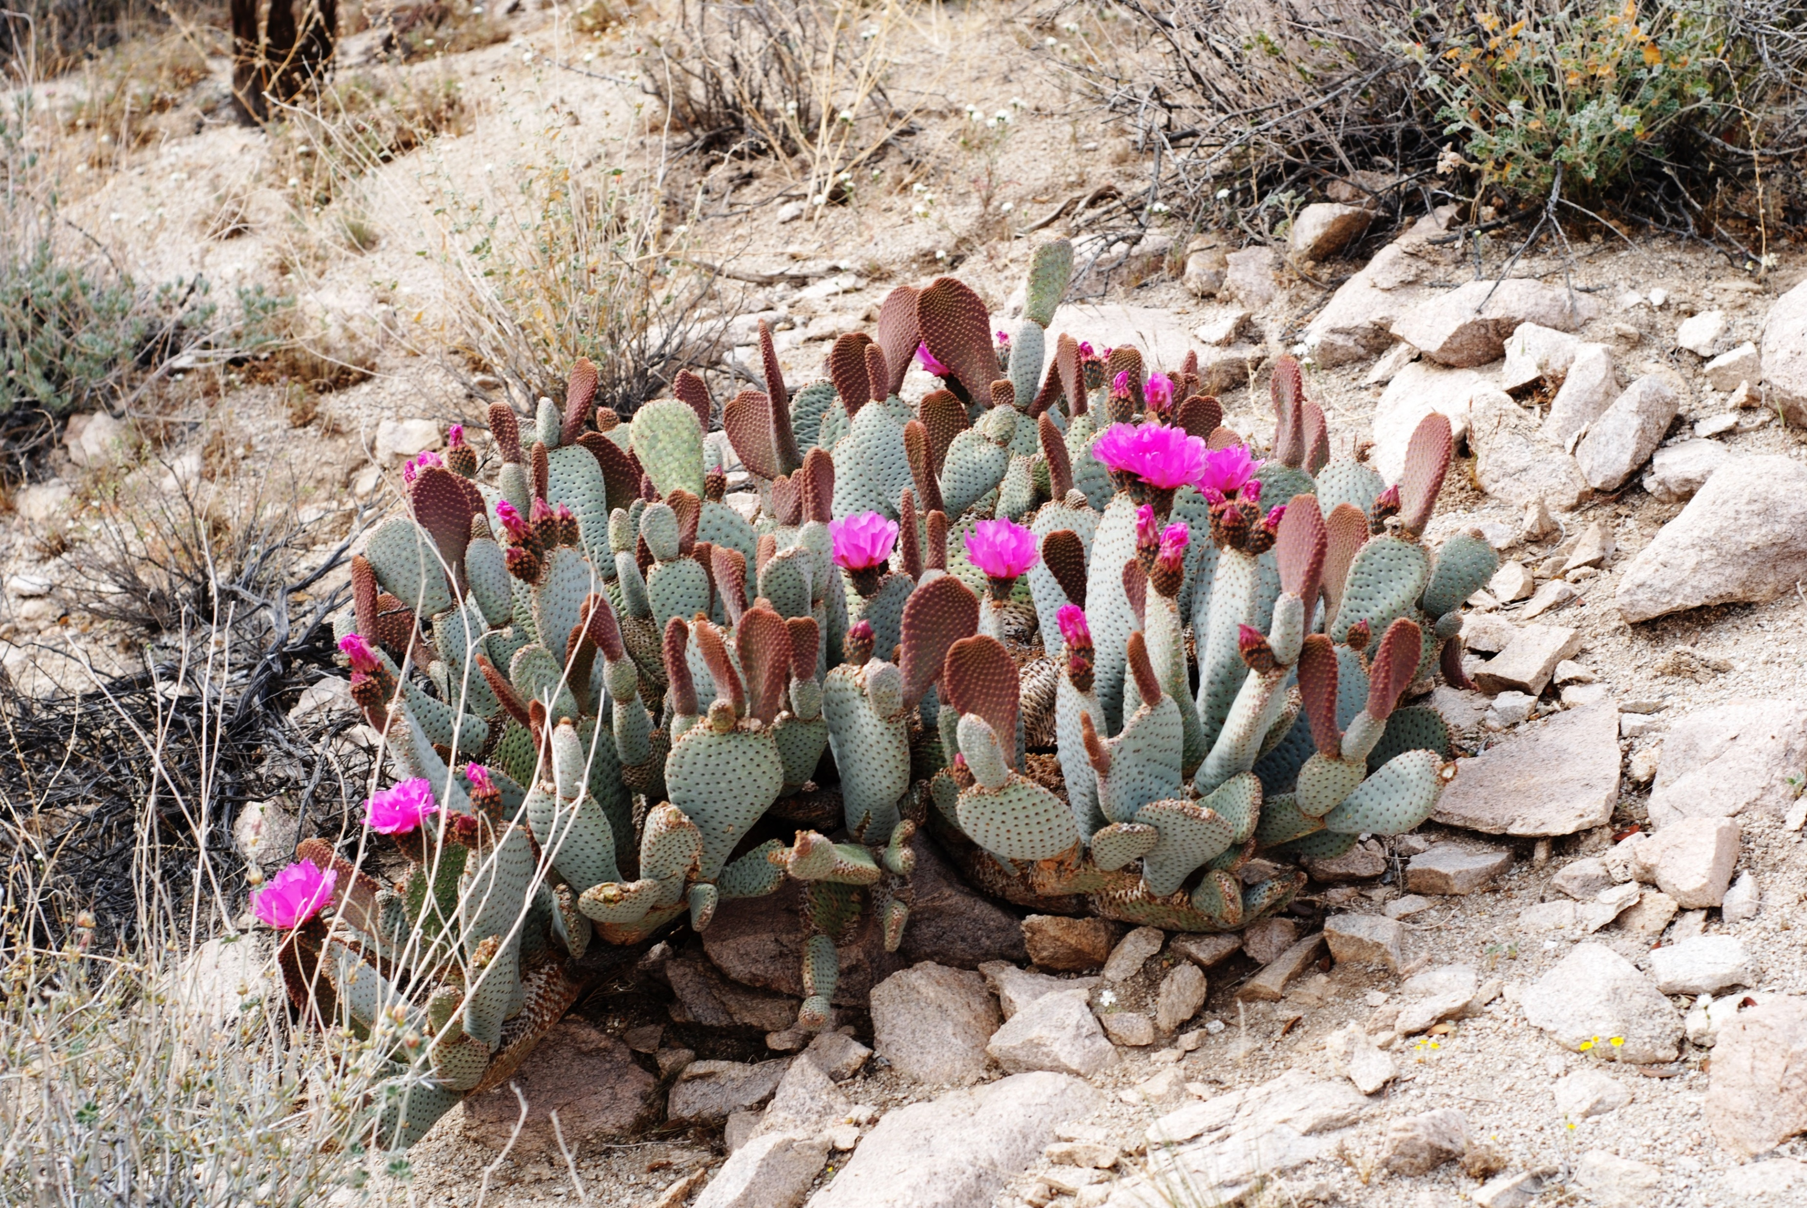
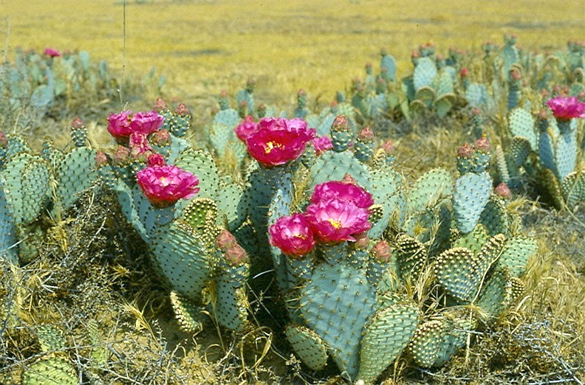
Study Species
Opuntia basilaris var. basilaris,
Beavertail
Opuntia basilaris var. treleasei,
Bakersfield Cactus
Endangered
Cylindropuntia anthrocarpa,
Buckhorn Cholla
Photos: Beavertail By Jarek Tuszyński / CC-BY-SA-3.0, CC BY-SA 3.0, https://commons.wikimedia.org/w/index.php?curid=32296209, Bakersfield cactus https://www.fs.fed.us/wildflowers/Rare_Plants/profiles/TEP/opuntia_basilaris_treleasei/images/opuntia_basilaris_treleasei_lg.jpg, Buckhorn Cholla https://www.tripadvisor.com/LocationPhotoDirectLink-g45973-d12337276-i316774403-Gold_Butte_National_Monument-Mesquite_Nevada.html

Slide 14
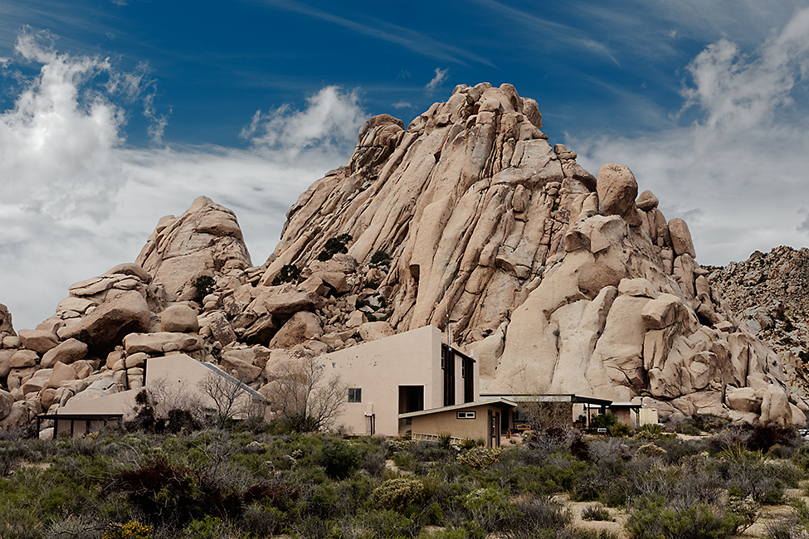
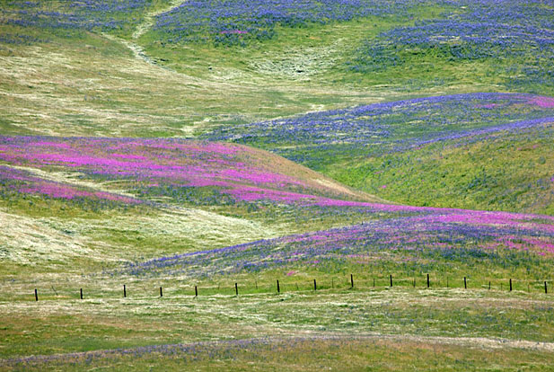
Study Sites
Sweeny Granite Desert Research Center:
O. basilaris var. basilaris & Cylindropuntia anthrocarpa
Wind Wolves Preserve
O. basilaris var. treleasei
http://www.paradise-fall.com/html/Wind+Wolves+Preserve

Slide 15
Methods: Site Metrics
100m
10m
Cactus density/diversity
Transects: 100m each, every 5m, 10m apart, 6 replicates
Bird density/diversity
1km transects
Every 7 days
All birds seen or heard
Cactus metrics
100 individuals of each species
Branching
X, Y, Z
5m

Slide 16
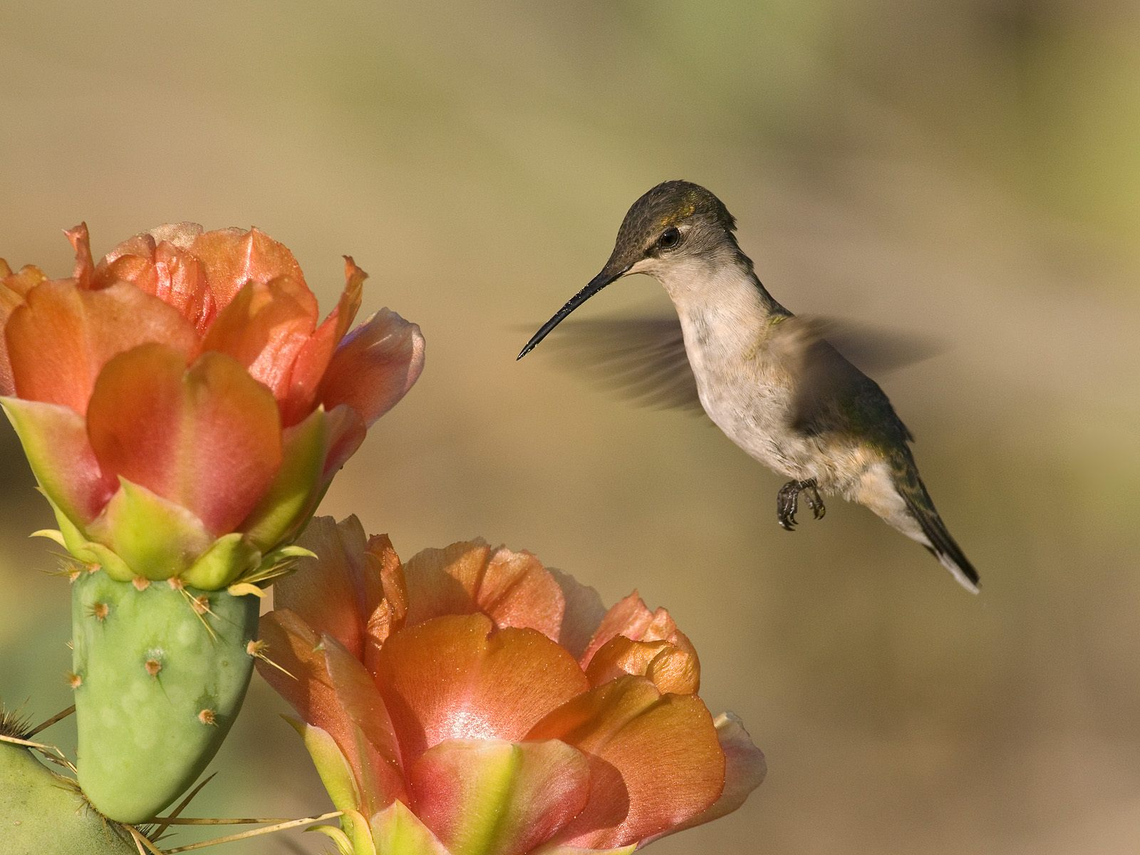
Methods: Flowering Experiment
10 replicates of each combination of variables
270 total individuals
Showiness
Manipulated: 0%, 50%, 100% buds on cactus
Remove
Size
Small, medium, large
Binned after preliminary field season
Species
O. basilaris var. basilaris, O. basiliaris var. treleasei, C. anthrocarpa
Notes:
10 reps of each combo of variables, which
Number of flower buds present on the cactus, which is a measurement of showiness
Size, which will be binned after the preliminary February field season
And species

Slide 17
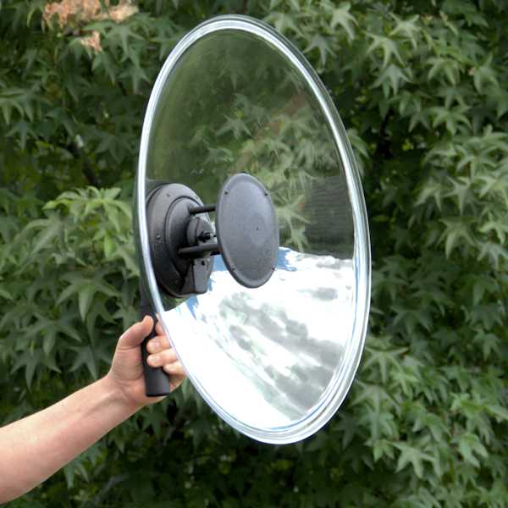
Methods: Flowering Experiment
Focal observations
200-500mm digital camera
1 hour sessions in morning/evening
4 replications per variable combination and open
112 hours total
Ethogram
Audio recordings
Unidirectional audio recorder
Parabolic shield
ad libitum
Concurrent with focal observations

Slide 18
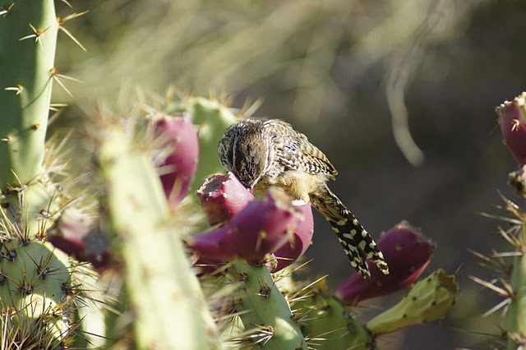
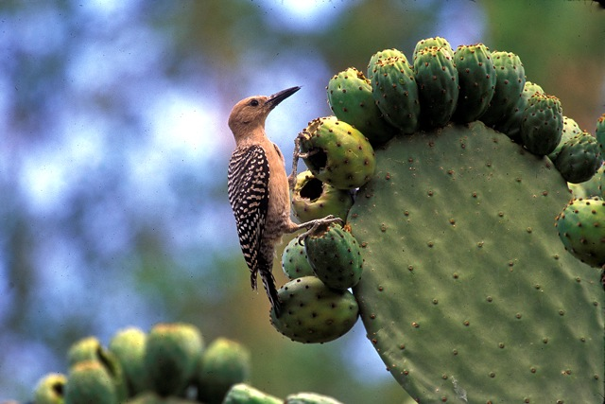
Methods: Fruiting Experiment
10 replicates of each combination of variables
270 total individuals
Manipulated:
0%, 50%, 100% fruits on cactus
Collect in air-tight container to weigh and count seeds
Size
Small, medium, large
Binned after preliminary field season
Species
O. basilaris var. basilaris, O. basiliaris var. treleasei, C. anthrocarpa

Slide 19
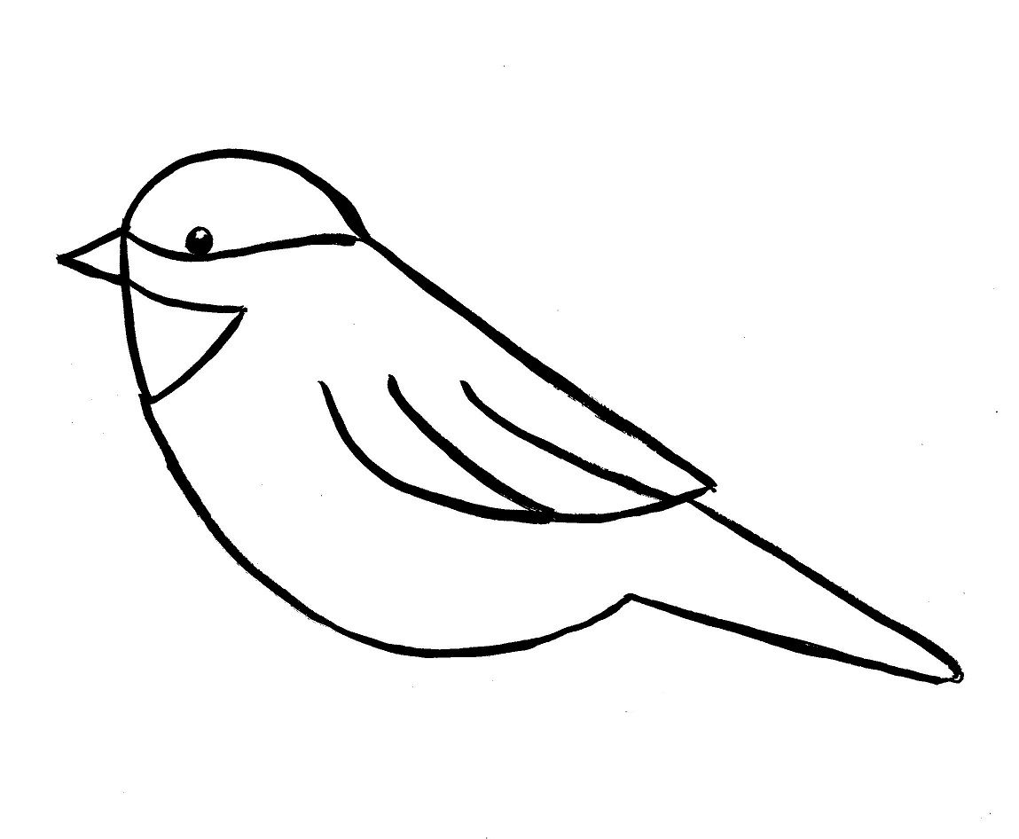

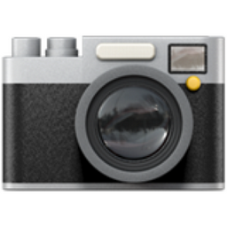
Methods: Fruiting Experiment
Focal observations
1 hour sessions in morning/evening
4 replications per variable combination and open
112 hours total
Audio recordings
Camera traps
2 cameras at every combination of variables
One facing cactus, one facing open area
5 days left to photograph
After 5 days, camera moved to new cactus
5 reps (25 total days)
5m

Slide 20
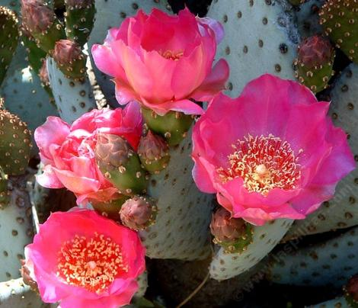
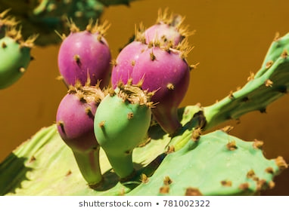
Paired Flower-Fruit Observations
Fruiting and flowering manipulations won’t be the same cacti
Possible that flowers won’t fruit, could lead to issues in fruiting season
Lat-long of 20 individuals of each species
x, y, z
Number of branches
Number of flowers -> fruit
Sucrose content of flowers (radiometer)
Establish flowering patterns impact on fruiting patterns of different cacti characteristics

Slide 21
Chapter 3: Avian pollination and seed dispersal influence on seed shadow of Cactaceae obligate protege plants
Purpose:
Test the importance of birds as pollinators/seed dispersers for cacti which are, at different life stages, beneficiaries and benefactors of facilitating plants and animals respectively.
Research Questions:
Does flower number predict fruit number?
Do larger cacti produce more flowers/fruits, or higher mass fruits than smaller cacti?
Do larger fruits produce more seeds, or higher mass seeds than smaller fruits?
Are frugivorous birds more frequent at for larger cacti?
Are pollinating birds (hummingbirds) optimally foraging at larger cacti?
Do birds produce seed rain in favorable habitats for germinating seedlings (under a benefactor shrub canopy)?

Slide 22
Hypothesis & Predictions
Hypothesis: Positive interactions between birds and cacti are the limiting factor in cacti distribution to the canopy of a benefactor shrub, with plant size and allocation being a determining factor in interaction strength.
Predictions:
a. Cacti reproduction effort is size-dependent, and fruit and seed size are positively correlated.
b. Bird visitation rates for pollination and frugivory are positively related to cacti size and floral display.
c. The bird-cacti relationship is species specific (both for bird and cacti species).
d. Frugivorous birds are perching in spaces for depositing seed rain in optimal germination habitats (under benefactor shrubs.)

Slide 23
Variables
Factors
Mesohabitat: Open/Cactus
Species
Size: Small, Medium, Large
Percent fruit/flower: 0%, 50%, 100%
Responses
Mass of individual fruits
Mass of individual seeds
Number of flowers per cactus
Number of fruits per cactus
Number of seeds per fruit
Species richness and diversity per cactus
Proportion of frugivorous birds present relative to non frugivorous birds
Frugivorous bird visitation rate at cacti and benefactor shrub
Species richness and diversity per benefactor shrub
Proportion of frugivorous birds present relative to other species per benefactor shrub

Slide 24
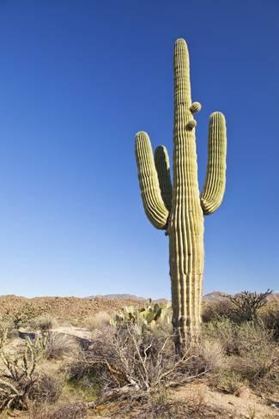
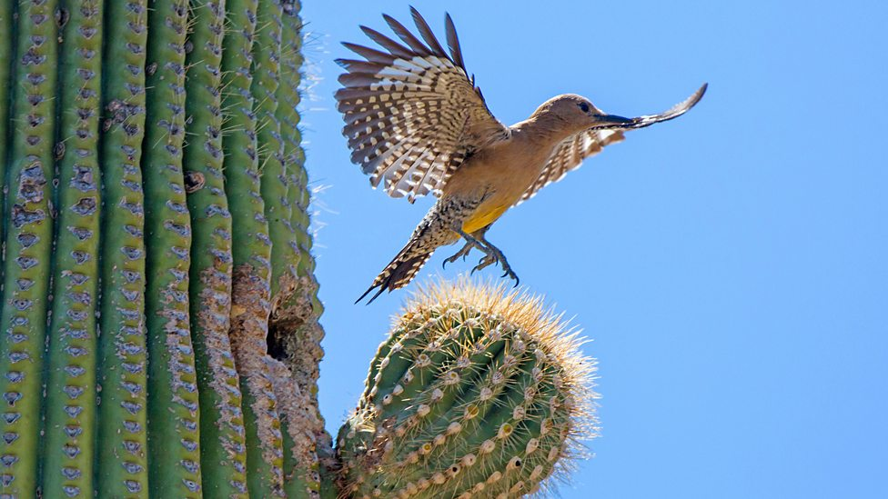
Study Species
Carnegiea gigantea,
Saguaro

Slide 25
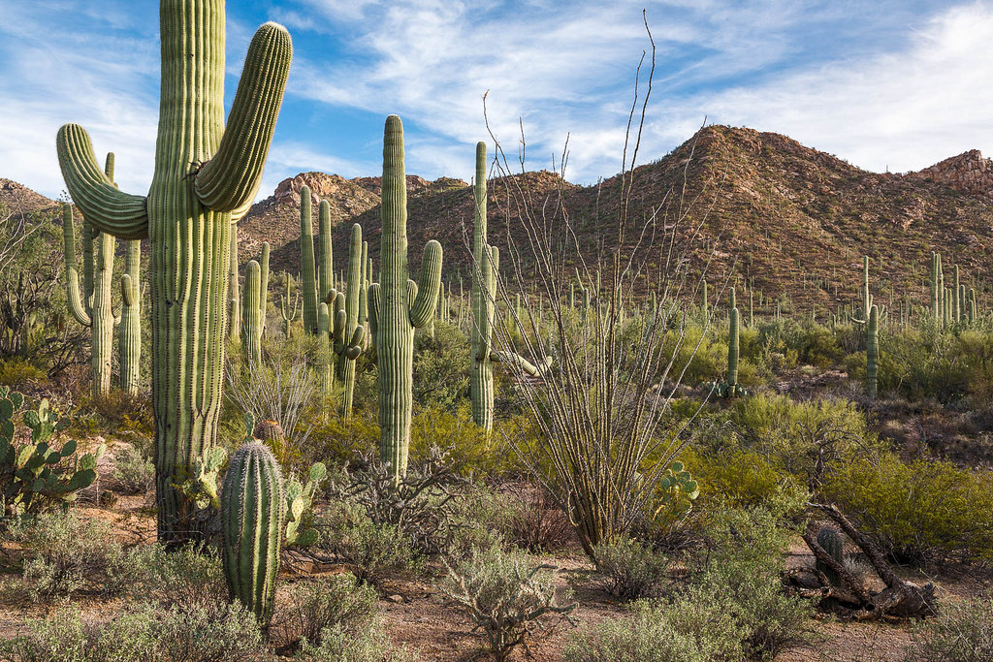
Study Sites
TBD Sites in Sonoran Desert
Arizona
Expedition with team to find Saguaro and shrub lands

Slide 26
Methods: Site Metrics
Cactus density/diversity
Transects: 100m each, every 5m, 10m apart, 6 replicates
Bird density/diversity
1km transects
Every 7 days
All birds seen or heard
Cactus metrics
100 individuals of each species
Branching
X, Y, Z
Same as Chapter 2

Slide 27
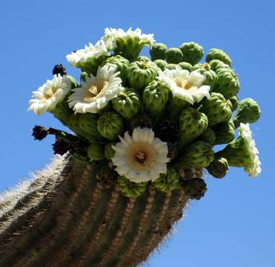
Methods: Flowering Experiment
10 replicates of each combination of variables
90 total individuals
Showiness
Manipulated: 0%, 50%, 100% buds on cactus
Remove
Size
Small, medium, large
Binned after preliminary field season
Species
Carnegiea gigantea

Slide 28
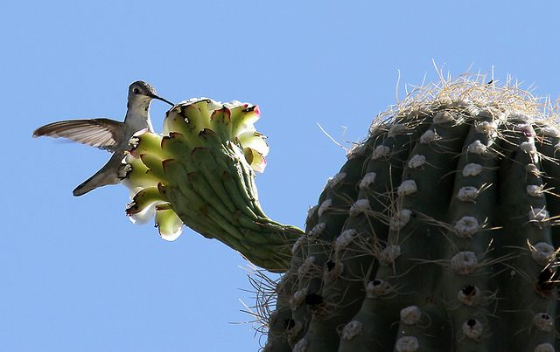
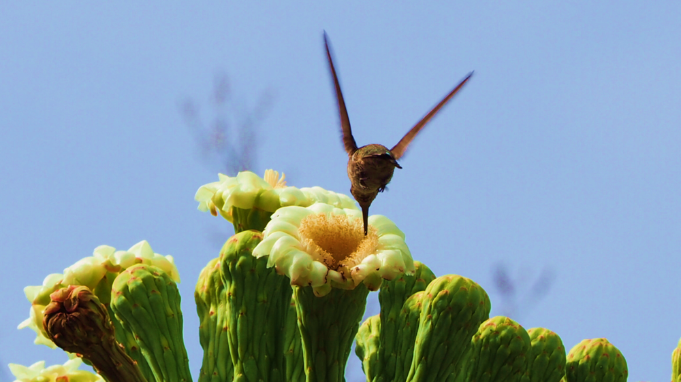
Methods: Flowering Experiment
Focal observations
200-500mm digital camera
1 hour sessions in morning/evening
4 replications per variable combination and open
40 hours total
Ethogram
Audio recordings
Unidirectional audio recorder
Parabolic shield
ad libitum
Concurrent with focal observations

Slide 29
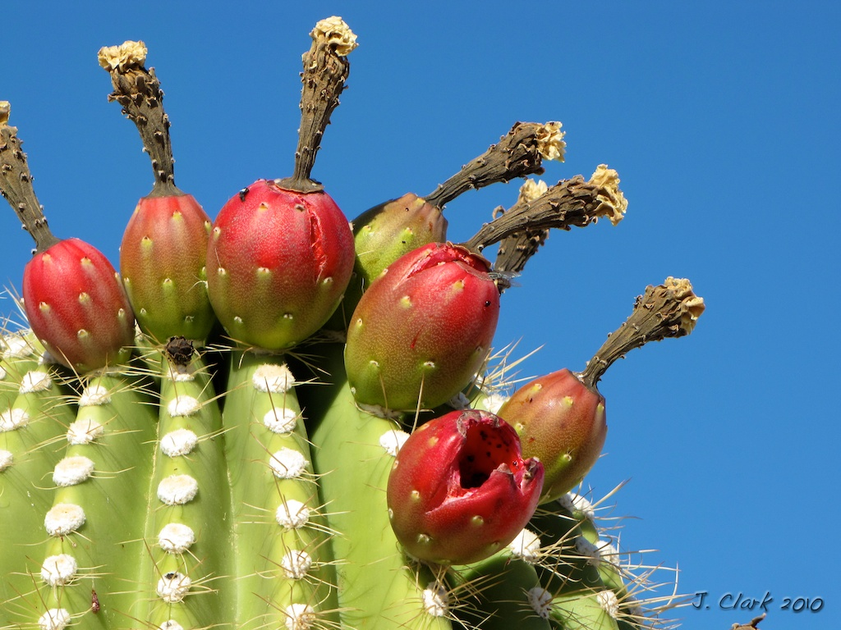
Methods: Fruiting Experiment
10 replicates of each combination of variables
90 total individuals
Showiness
Manipulated: 0%, 50%, 100% fruits on cactus
Collect in air-tight container to weigh and count seeds
Size
Small, medium, large
Binned after preliminary field season
Species
Carnegiea gigantea

Slide 30
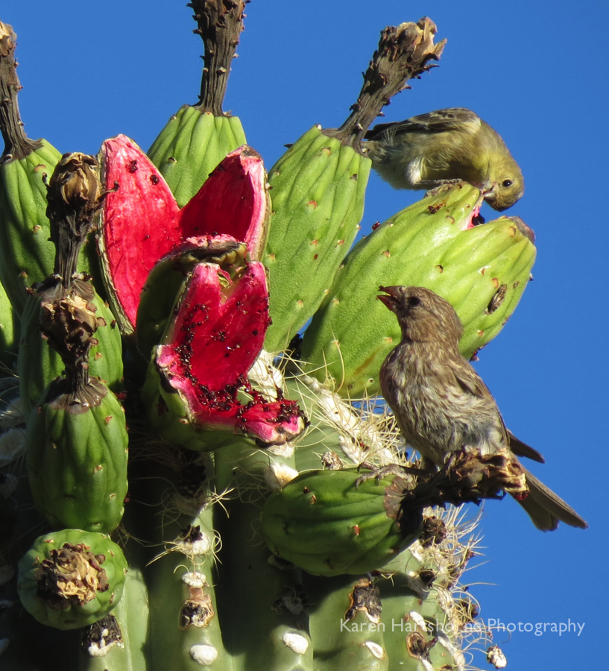
Methods: Fruiting Experiment
Focal observations
1 hour sessions in morning/evening
4 replications per variable combination and open
Audio recordings
Camera traps
2 cameras at every combination of variables
One facing cactus, one facing open area
5 days left to photograph
After 5 days, camera moved to new cactus
5 reps (25 total days)

Slide 31
Paired Flower-Fruit Observations
Fruiting and flowering manipulations won’t be the same cacti
Possible that flowers won’t fruit, could lead to issues in fruiting season
Lat-long of 20 individuals
x, y, z
Number of branches
Number of flowers -> fruit
Sucrose content of flowers (radiometer)
Establish flowering patterns impact on fruiting patterns of different cacti characteristics

Slide 32
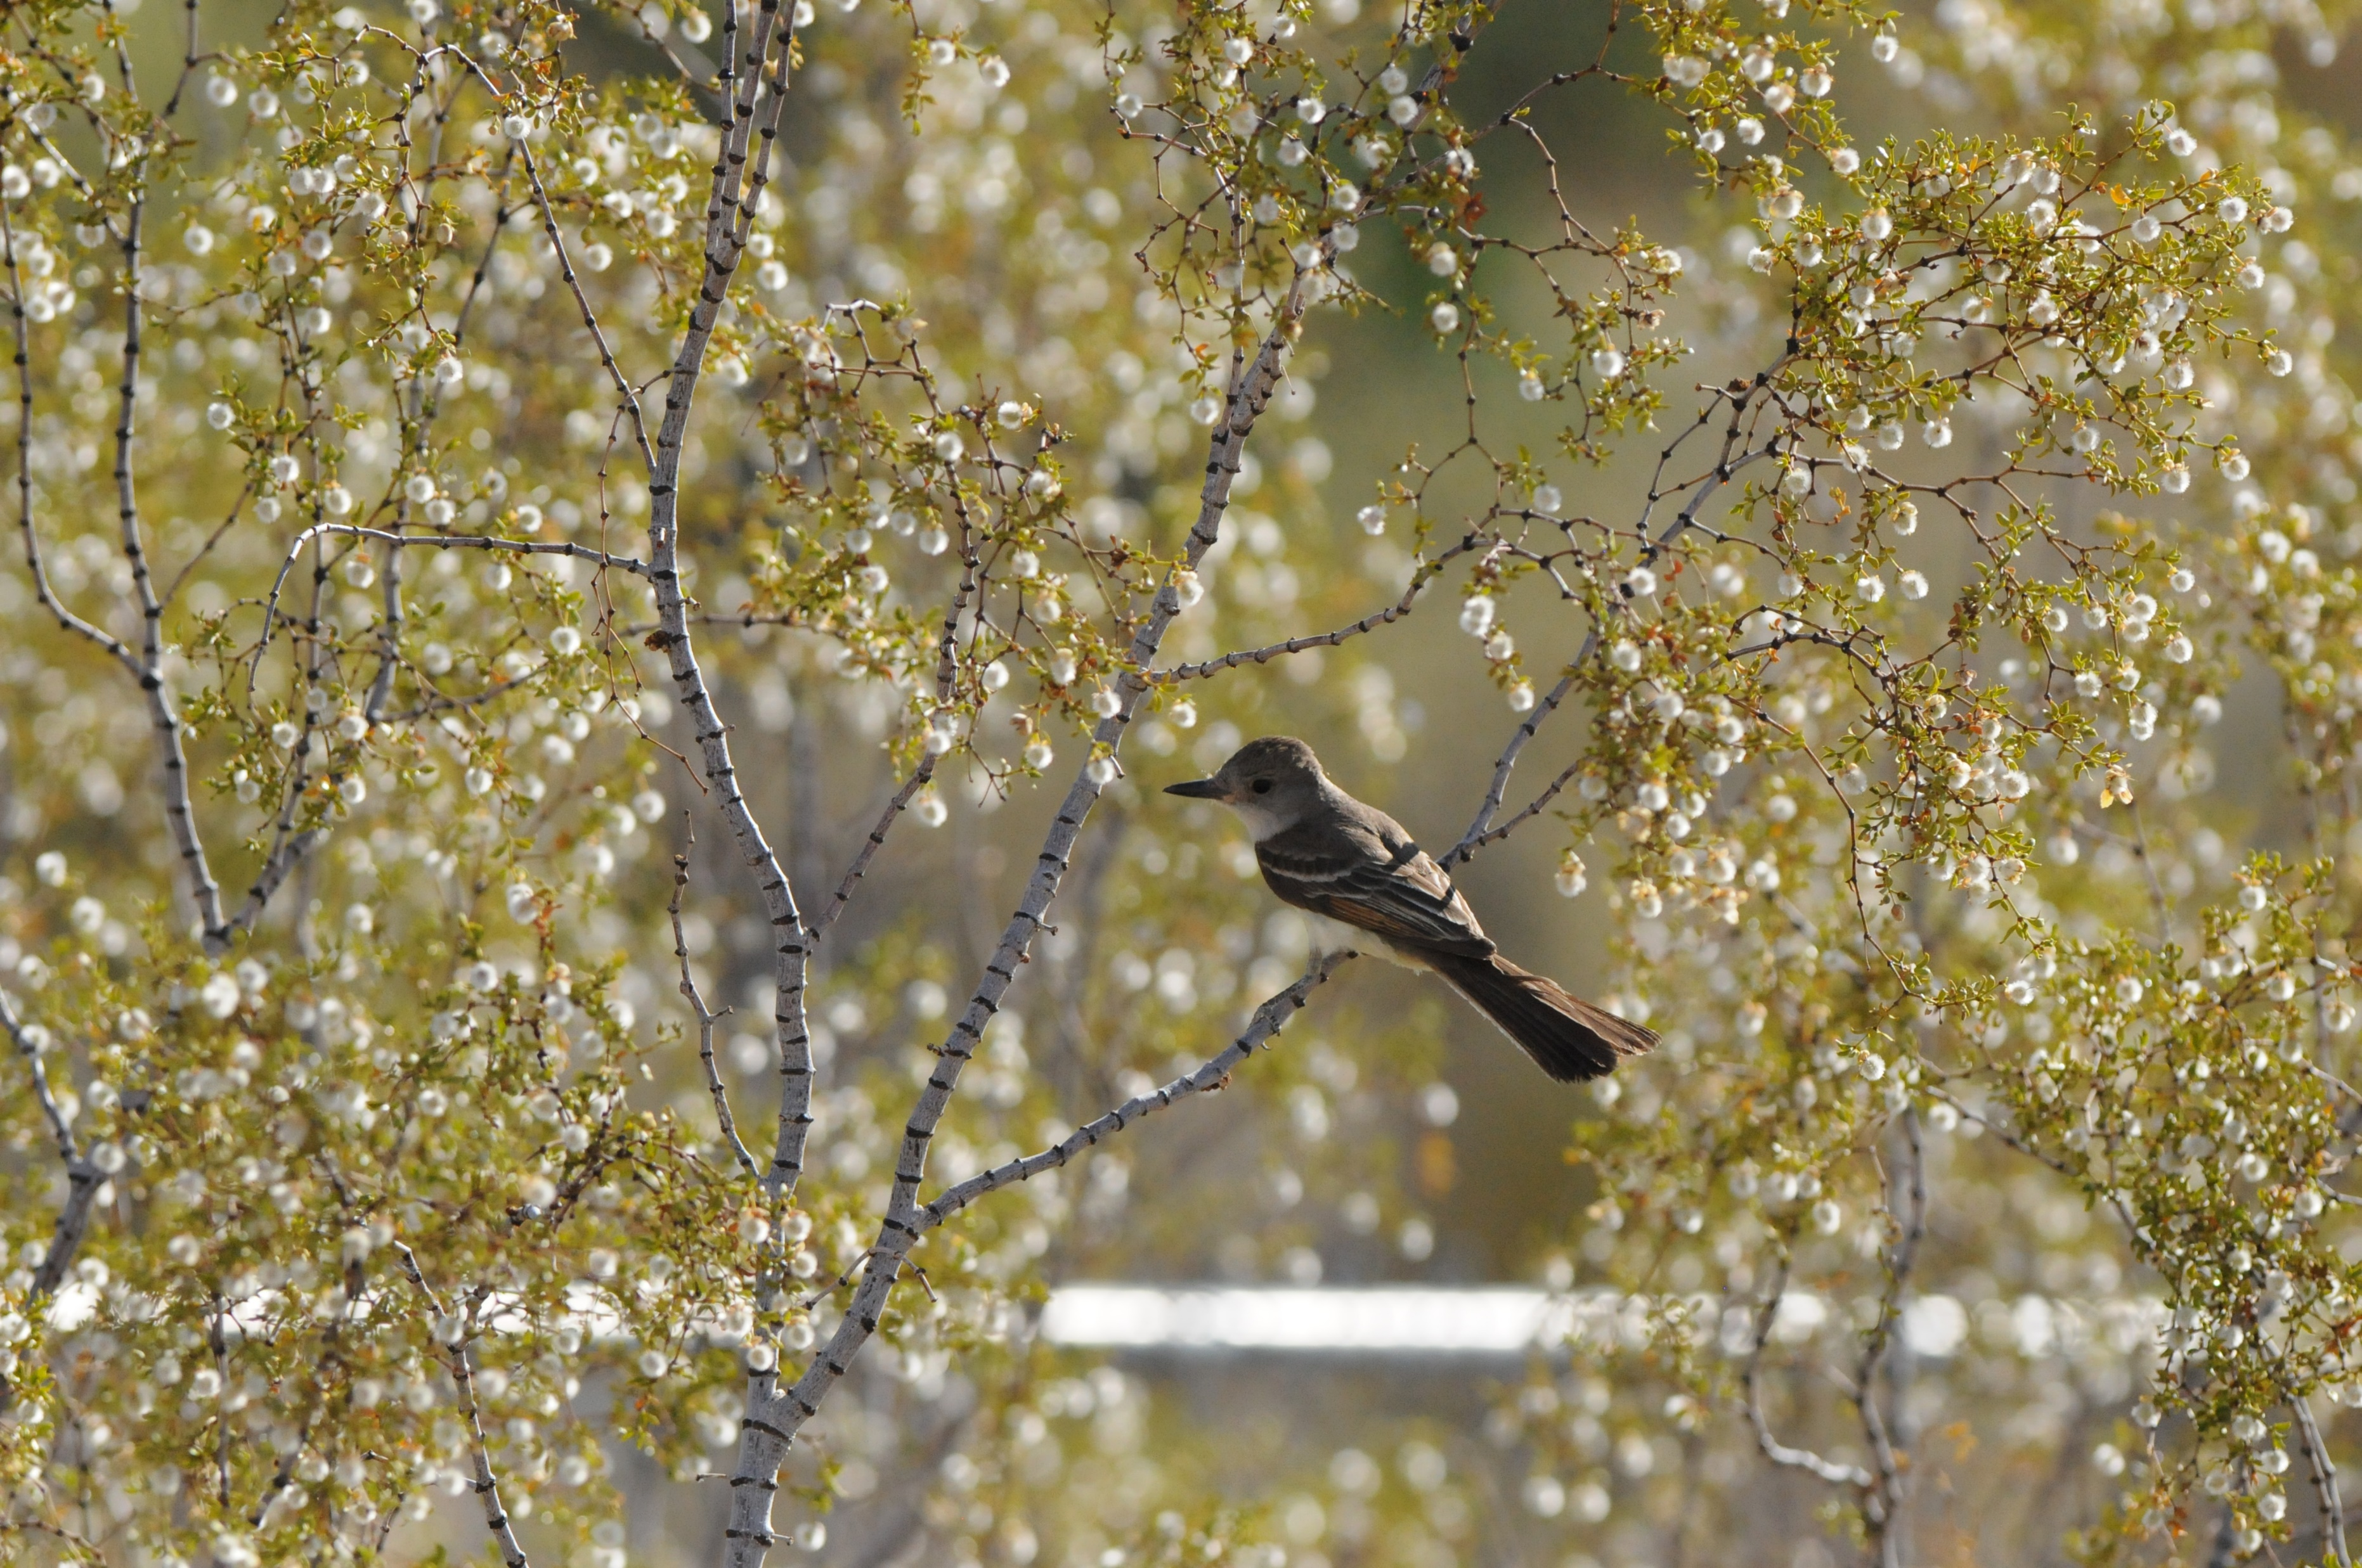
Benefactor Shrub Canopy
Determine if frugivorous birds perch on benefactor shrubs
Randomly select 100 shrub individuals
Count number/proportion of saguaro juveniles:
Under shrub canopy versus in open
Camera traps
2 camera traps at paired shrub/open sites
5 days replicates, 25 days total
Notes:
Do frugivorous birds perch on benefactor shrubs?
Image, you can see ash-throated flycatcher (an insectivorous bird) perching on Larrea tridentate, a known benefactor shrub for saguaro

Slide 33
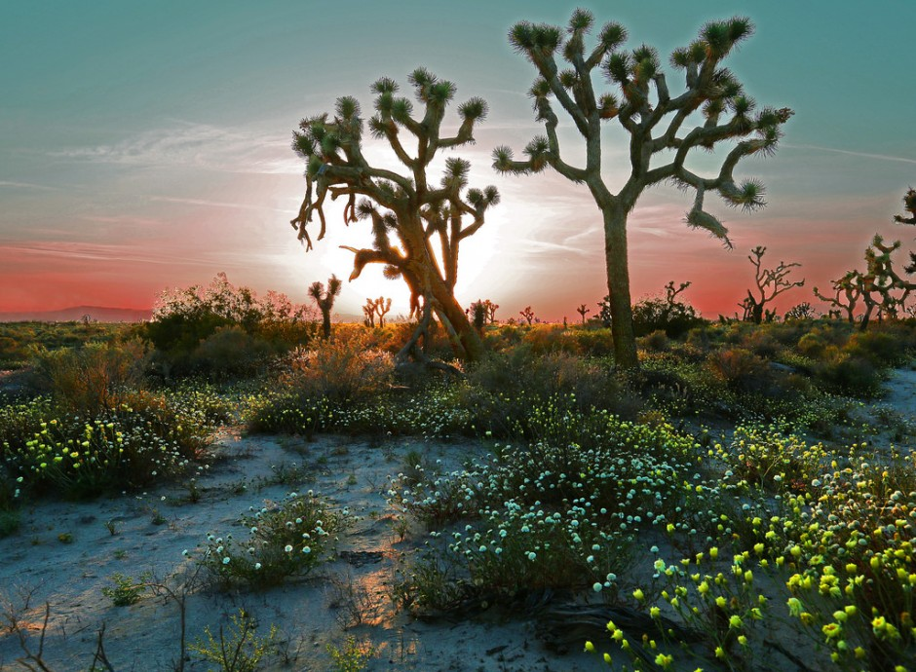
Side/Future Projects
This project opens ideas for collaboration
Seed trays
Nutrition content of fruit
Seed predation after bird digestion
Team of 4-6 undergrad assistants
1 who would like to head up seed trays

Slide 34
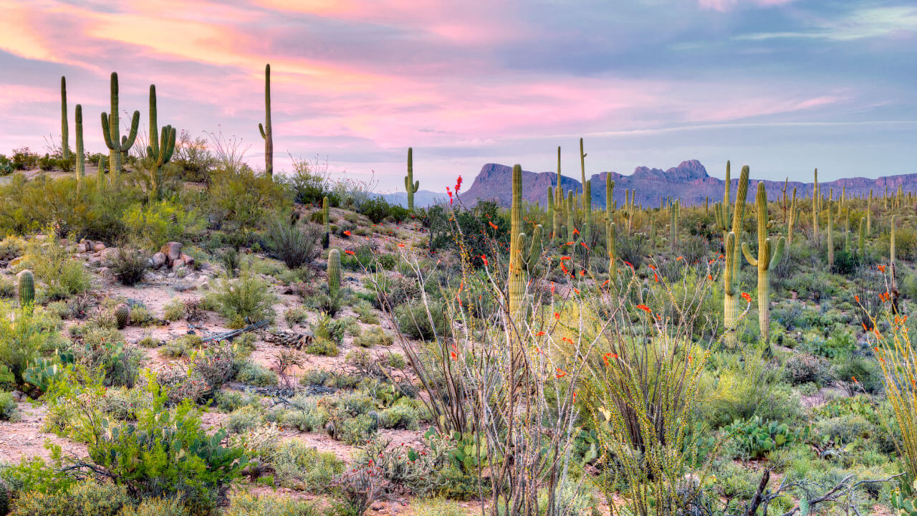
Thanks for listening!
Let’s chat.

